Slide 1
Operation Remote Resupply PART 4
Xamarin + Azure Mobile

Slide 2



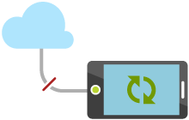
Azure Mobile
Native platform SDKs for managing services
Enterprise service integration
Offline sync and local storage capabilities
Push notification services
Authorization and authentication services
Notes:
Azure Mobile Apps are an Azure App Service, which means, just like any other Azure App Service, provide a highly scalable, globally available mobile application development platform for developers that brings a rich set of capabilities specifically tailored to mobile developers, including:
Native platform SDKs for managing services
Enterprise service integration
Offline sync and local storage capabilities
Push notification services
Authorization and authentication services

Slide 3
Azure Mobile Services
Windows
iOS
Android
HTML 5
Cloud Storage
Offline Synchronization
User Authentication
REST API
Push Notifications
Notes:
Mobile apps need to store data, and most users want their information available all the time, whether online or offline. Mobile apps need authentication and authorization to ensure the integrity and privacy of the data being sent, and modern mobile apps need an intuitive and reliable framework for real-time user notification and communication that can seamlessly broadcast information across a huge variety of platform variations and devices.
Azure Mobile Apps services, like cloud storage, offline synchronization, user authentication, and push notifications are all exposed to a developer via both SDK and REST-based APIs services.

Slide 4

Using the Azure Mobile SDK
Add the SDK directly or via a NuGet Package
Write common code to class services
Write platform-specific code to interact with the SDK
Manage individual configurations via Azure portal
public async Task<bool> SignInAsync()
{
bool isSuccessful = false;
try
{
user = await TelemetryManager.DefaultManager.CurrentClient.LoginAsync(this, MobileServiceAuthenticationProvider.MicrosoftAccount);
isSuccessful = user != null;
}
catch { }
return isSuccessful;
}
Notes:
This example, which comes from Lab 4, uses the Azure Mobile SDK LoginAsync() method to prompt a user for Microsoft account credentials. Although this example is taken from app’s Android project, the platform-specific code for iOS and Windows looks identical.

Slide 5
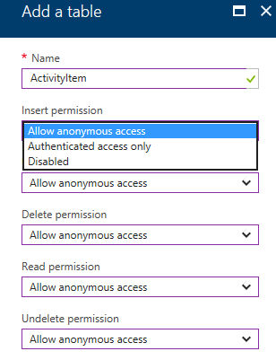
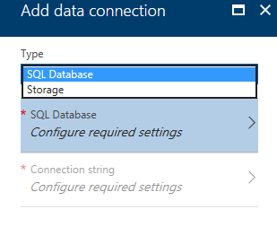

Azure Mobile Data and Storage
Created using either Azure SQL Database or Azure Storage
Can backend Easy tables
Can backend Easy APIs
Integrated with Azure Mobile SDK
Integrated with Azure Mobile authentication
Notes:
All Azure Mobile data and storage services, including Easy tables and Easy APIs require a backend storage mechanism. Both Azure SQL Database and Azure Storage are supported as storage options. Easy tables and Easy APIs can be managed via the Azure portal (for Node.js backends) or more standard data and storage tools, such as SQL Server Management Studio (for C# backends)

Slide 6
Integrating Mobile Data and Storage
All basic CRUD methods are supported
Built-in list and enumerable return methods
Automatic row identity management
Dynamic schemas based on “code first” concepts
public class ActivityItem
{
public string Id { get; set; }
public string Status { get; set; }
public string Description { get; set; }
public DateTime ActivityDate { get; set; }
}
IEnumerable<ActivityItem> items =
await activitiesTable.ToEnumerableAsync();
await activitiesTable.InsertAsync(item);
Notes:
These examples, which comes from Lab 4, show the ActivityItem class which maps directly to an Azure Mobile table schema, as well as code that uses the Azure Mobile SDK ToEnumerableAsync method to return an enumerable list of ActivityItems, and the InsertAsync method to add a record to the ActivityItem table for recording drone landing attempt history.

Slide 7
Integrating Mobile APIs
public async Task<string> Post(TelemetryItem telemetry)
{
await Helpers.TelemetryHelper.
SendToMissionControlAsync(telemetry);
return $"Telemetry received by Mission Control.";
}
TelemetryItem telemetry = new TelemetryItem()
{
.
.
};
await TelemetryManager.DefaultManager.CurrentClient.
InvokeApiAsync("telemetry", JToken.FromObject(telemetry));
Notes:
Using the Azure SDK to call backend APIs occurs via the InvokeApiAsync method which support both generic and strongly-typed return values.
These examples, which comes from Lab 4, demonstrates both the backend service Post method exposed as an API, and the corresponding client-side InvokeApiAsync call to send real time telemetry data to an Azure Mobile backend via the Azure Mobile Client SDK. For brevity, the actual TelemetryItem properties have been removed in this example.

Slide 8
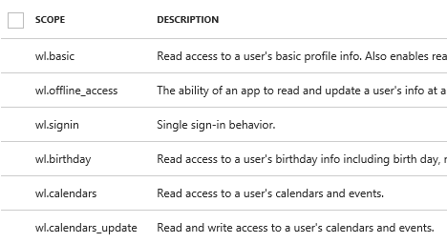
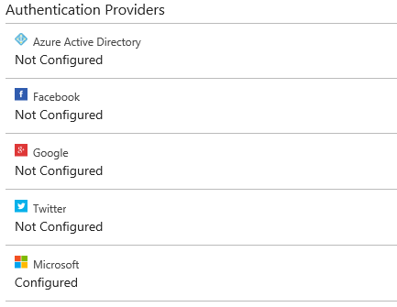
Azure Mobile Authentication
Uses Azure App Service authentication and authorization services
Uses the concept of federated identities
Allows other providers
Allows custom identity solutions
Notes:
Azure Mobile App Services use standard Azure Mobile App authentication and authorization scenarios. Azure App authentication is a services that enables an pp to sign users in and out with no code changes required on the app backend, providing an easy way to protect your application and work with per-user data.
Azure App Services use federated identities in which a 3rd-party identity provider stores accounts and authenticates users, and the app uses this identity instead of its own.
Azure App Services support five identity providers out of the box: Azure Active Directory, Facebook, Google, Microsoft Account, and Twitter. You can also expand this support for your apps by integrating other identity providers, or even your own custom identity solution.

Slide 9
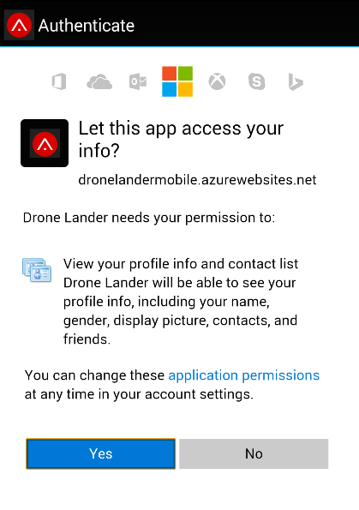
Mobile Authentication Flow
Mobile App Client
Authentication Provider
Mobile App Backend
Azure Mobile Services
Notes:
Azure Mobile authentication can be applied at various levels:
The entire mobile service
Specific objects, such as tables
Specific classes or controllers
Specific methods
In all these scenarios, a client app makes a request for credentials, and the mobile service prompts a user, generates a token, and passes the token claim back to the actual service in question, such as a data table or method call.

Slide 10
Lab Walkthrough
Xamarin + Azure Mobile

